Slide 1
IaaS Migration Solution for Customer XX
2023-XX-XX

Slide 2
Project Background
Subtitle (one line)
Project background/Industry introduction (Example)
xxx deployed all of its xx services in the East China region of A3 Cloud and spent over xxx dollars annually on the cloud. To reduce costs, improve the system architecture, and avoid potential competition with A3 in e-commerce services, xxx decided to migrate all services from A3 Cloud to Huawei Cloud.
Migration requirement analysis (Example)
The customer's IDC lease contract will expire. Migration solutions are required and the pros and cons need to be analyzed to assist in decision-making.
The call center system will also need to be migrated together with the service system. A migration solution is required and the cost risks need to be evaluated to help prepare for the migration.
The IDC equipment is outdated and has many known issues. A new system architecture with DR design is required to address these problems.

Slide 3

Original Architecture
User/System
External
Access Layer
Web/App
Cache/ Middleware
Database
Object Storage
Nginx reverse proxy (X nodes)
Client
ELB
Redis cache (X nodes)
Customize this slide based on customer services.
Region A
S3
k8s application service (XX nodes)
MySQL (X nodes)
Nginx reverse proxy (X nodes)
Redis cache (X nodes)
ELB
S3
Region B
MySQL/Aurora-MySQL (X nodes)
k8s application service (XX nodes)

Slide 4
New Architecture
User/System
External
Access Layer
Web/app
Cache/ Middleware
Database
Object Storage
Nginx reverse proxy (X nodes)
Client
ELB
Redis cache (X nodes)
Customize this slide based on customer services.
Huawei region A
OBS
k8s application service (XX nodes)
RDS for MySQL (X nodes)
Nginx reverse proxy (X nodes)
Redis cache (X nodes)
ELB
OBS
Huawei region B
RDS for MySQL (X nodes)
k8s application service (XX nodes)

Slide 5
Migration Tools
Component | Peer Vendor's Cloud Service | Huawei Cloud Service | Migration Tool
Application service | ECS | ECS | Server Migration Service (SMS)
Object storage | OSS | OBS | Object Storage Migration Service (OMS)
File storage | NAS | SFS | Rclone
Customize this slide based on customer services.

Slide 6
Migration Process
Source (AWS)
Destination (Huawei Cloud)
0
Design a solution (3 weeks before the maintenance window)
Backup
Create resources (such as load balancers, VPCs, subnets, ECSs, and RDS databases)
Collect customer information and analyze their requirements.
Design a solution.
Test and verify the solution.
Apply for a maintenance window and set up a migration team.
1
Configure NAT gateways and firewall policies
1
Prepare the destination (2 weeks before the maintenance window)
Create auto scaling groups
Create VPCs, subnets, security groups, VMs, and RDS databases.
Back up data of the destination.
Configure the source and destination, set up a migration network, and configure the bandwidth.
ELB
Reconfigure
Customize this slide based on customer services.
ELB
k8s
Redeploy
k8s
2
Deploy applications at the destination (2 weeks before the maintenance window)
2
Deploy applications on destination servers and create private images for the servers.
Create auto scaling groups.
Deploy k8s and DCS.
Create RDS databases. Create tasks for using DRS to fully and incrementally migrate databases.
Create OBS buckets. Create tasks for using OMS to fully and incrementally migrate objects.
Verify private images, auto scaling, and databases.
Delete dirty data from databases and configure DRS migration tasks again.
Redis
Redeploy
DCS
DRS and TurboDX for full and incremental synchronization
MySQL/Aurora
RDS for MySQL
OMS for full and incremental synchronization
S3
OBS
3
DRS and TurboDX for incremental synchronization
3
Migrate incremental data and switch over services (maintenance window)
MySQL
MySQL
Stop services
DNS settings modification
Service verification
Stop source services on source servers. Incrementally synchronize databases and objects.
Modify DNS settings and switch over services.
Verify services.
4
Continuous monitoring and observation
4
Continuously monitor the system and clean up resources (1 week after the migration)
Resource release
Temporary resource cleanup

Slide 7
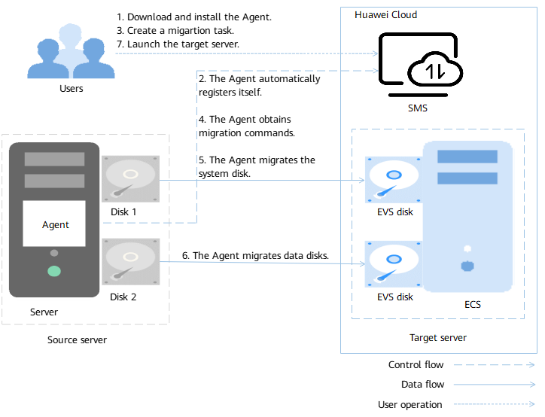
Server Migration Solution
Procedure
The user installs the Agent on the source server.
The Agent registers its connection status with SMS and reports information about the source server to SMS.
On the SMS console, the user configures the target server and starts the migration.
The Agent receives and executes the migration commands sent by SMS.
The Agent migrates the system disk of the source server.
The Agent migrates data disks of the source server.
The user launches the target server.
Parameters:
Source server is the server from which you are migrating workloads away.
Target server is the server to which you are migrating workloads.
SMS is the SMS service.
Customize this slide based on customer services.

Slide 8
Object Storage Migration Solution
Internet
Procedure
Source
Huawei Cloud
Obtain the AK/SK, region, and bucket name of both the source and destination storage.
On the OMS console, create a migration task, configure parameters, and start the migration. For example, create an incremental migration task to migrate objects generated after the last full migration.
On the migration page, view the task progress. The progress is refreshed every 10 seconds.
Check the result. If the task fails, restart it to perform the migration again.
Note: During the migration, objects will be obtained from the source object storage, generating downstream traffic. You can deploy CDN in the source environment to accelerate the download and reduce the transmission cost.
Customize this slide based on customer services.
App
App
Object storage
OMS migration task
OBS

Slide 9



File Storage Migration to Huawei Cloud SFS Through the Internet
Scenario
A customer wants to migrate file systems from on-premises IDCs or other clouds to Huawei Cloud SFS through the Internet.
Introduction
1. Rclone is a command line tool that can synchronize, upload, and download data between different file systems and object storage devices. In this solution, Rclone migrates data from the source file system to the destination and verifies the migration result.
2. Huawei Cloud SFS cannot be accessed through the Internet. So, data is transferred to SFS over SFTP.
Source
Destination
Rclone for full and incremental migration
Mount an NFS file system.
3
1
Customize this slide based on customer services.
2
Mount
Procedure
Internet
ECS
4
Write data to the mounted directory.
SFS
Buy an ECS with an EIP, enable the SFTP service, and mount the NFS file system created in SFS to the ECS.
Use Rclone to fully synchronize data to the mounted directory and perform incremental synchronizations for multiple times to minimize data inconsistency.
Stop services at the source and perform the last incremental synchronization at an appropriate time. Then, configure the services to write data to the destination buckets.
SFTP
NAS file system
Linux/Windows
Precautions
Data cannot be migrated through the Internet from local NAS devices to SFS Capacity-Oriented file systems.
Only ECSs running Linux can be used for data migration.
The UID and GID of your file will be different after synchronization.
The file access mode will be different after synchronization.
Port 22 is open to allow all inbound and outbound traffics.
Highlights
Rclone can synchronize, upload, and download data between different file systems and object storage devices.
Rclone can be used for incremental synchronization and consistency check.

Slide 10
Migration Process
7
1. Stop services at the source and stop writing service data.
2. Synchronize incremental data from source databases to destination databases (Huawei Cloud RDS for MySQL).
3. Check data consistency between the source and destination databases to ensure that the destination has obtained complete and accurate service data.
4. Start applications at the destination and test the application cluster.
5. Test the services.
6. Connect services to Huawei Cloud RDS for MySQL.
7. Modify the DNS settings and switch some traffic to the k8s service layer of Huawei Cloud.
8. Huawei Cloud RDS for MySQL processes requests both from services running on AWS and Huawei Cloud.
9. Divert all traffic to Huawei Cloud. The load balancers will distribute the traffic evenly among backend servers.
Stop services and stop writing data to databases and object storage.
Connect services to Huawei Cloud RDS databases.
Modify the DNS settings to switch some service traffic from AWS to Huawei Cloud.
Source (AWS)
1
6
Incrementally synchronize databases to the destination.
Customize this slide based on customer services.
Source database
2
Service traffic is diverted to AWS and Huawei Cloud.
8
Check data consistency between the source and destination databases.
Data verification
3
Huawei Cloud takes over all service traffic.
9
Destination
(Huawei Cloud)
Start applications.
Verify services.
4
5

Slide 11
Rollback Process
DNS
1. Rollback using DRS
Create a DRS replication task to fully and incrementally synchronize data from Huawei Cloud RDS for MySQL to Amazon RDS for MySQL.
If you need to roll back the migration, stop applications running on Huawei Cloud. Start the DRS task to synchronize data to Amazon RDS for MySQL. Stop the synchronization task when data in Amazon RDS for MySQL is consistent with that in Huawei Cloud RDS for MySQL.
Verify that the applications on AWS can access MySQL.
Modify the DNS settings to divert service traffic to AWS.
AWS
Huawei Cloud
ELB
ELB
Customize this slide based on customer services.
App
App
DRS and TurboDX for synchronization
2. Rollback using TurboDX
When you start migrating data from Huawei Cloud RDS for MySQL, start a synchronization from it to Amazon RDS for MySQL.
If you need to roll back the migration, stop applications and data writing on Huawei Cloud and wait for TurboDx to synchronize all incremental data to AWS.
When the data on AWS is consistent with that on Huawei Cloud, stop the TurboDX synchronization task.
Verify that applications on AWS can access databases.
Modify the DNS settings to divert service traffic to AWS.
Aurora/
MySQL
RDS
S3
Copy
OBS

